Slide 2
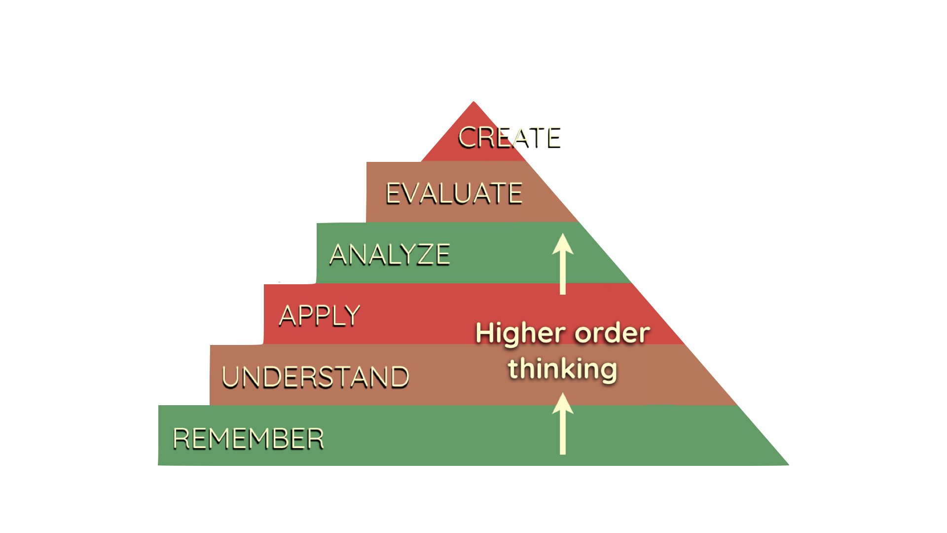
Notes:
Bloom’s taxonomy shows the orders of thinking, and it is obviously a goal of all teachers to encourage higher order thinking in students. Flipped learning facilitates this (demonstrated on later slides).

Slide 3
Notes:
The traditional model of teaching involves giving instruction and new content in class, and then assigning homework. This can be problematic as the students may need support while completing the homework.

Slide 4
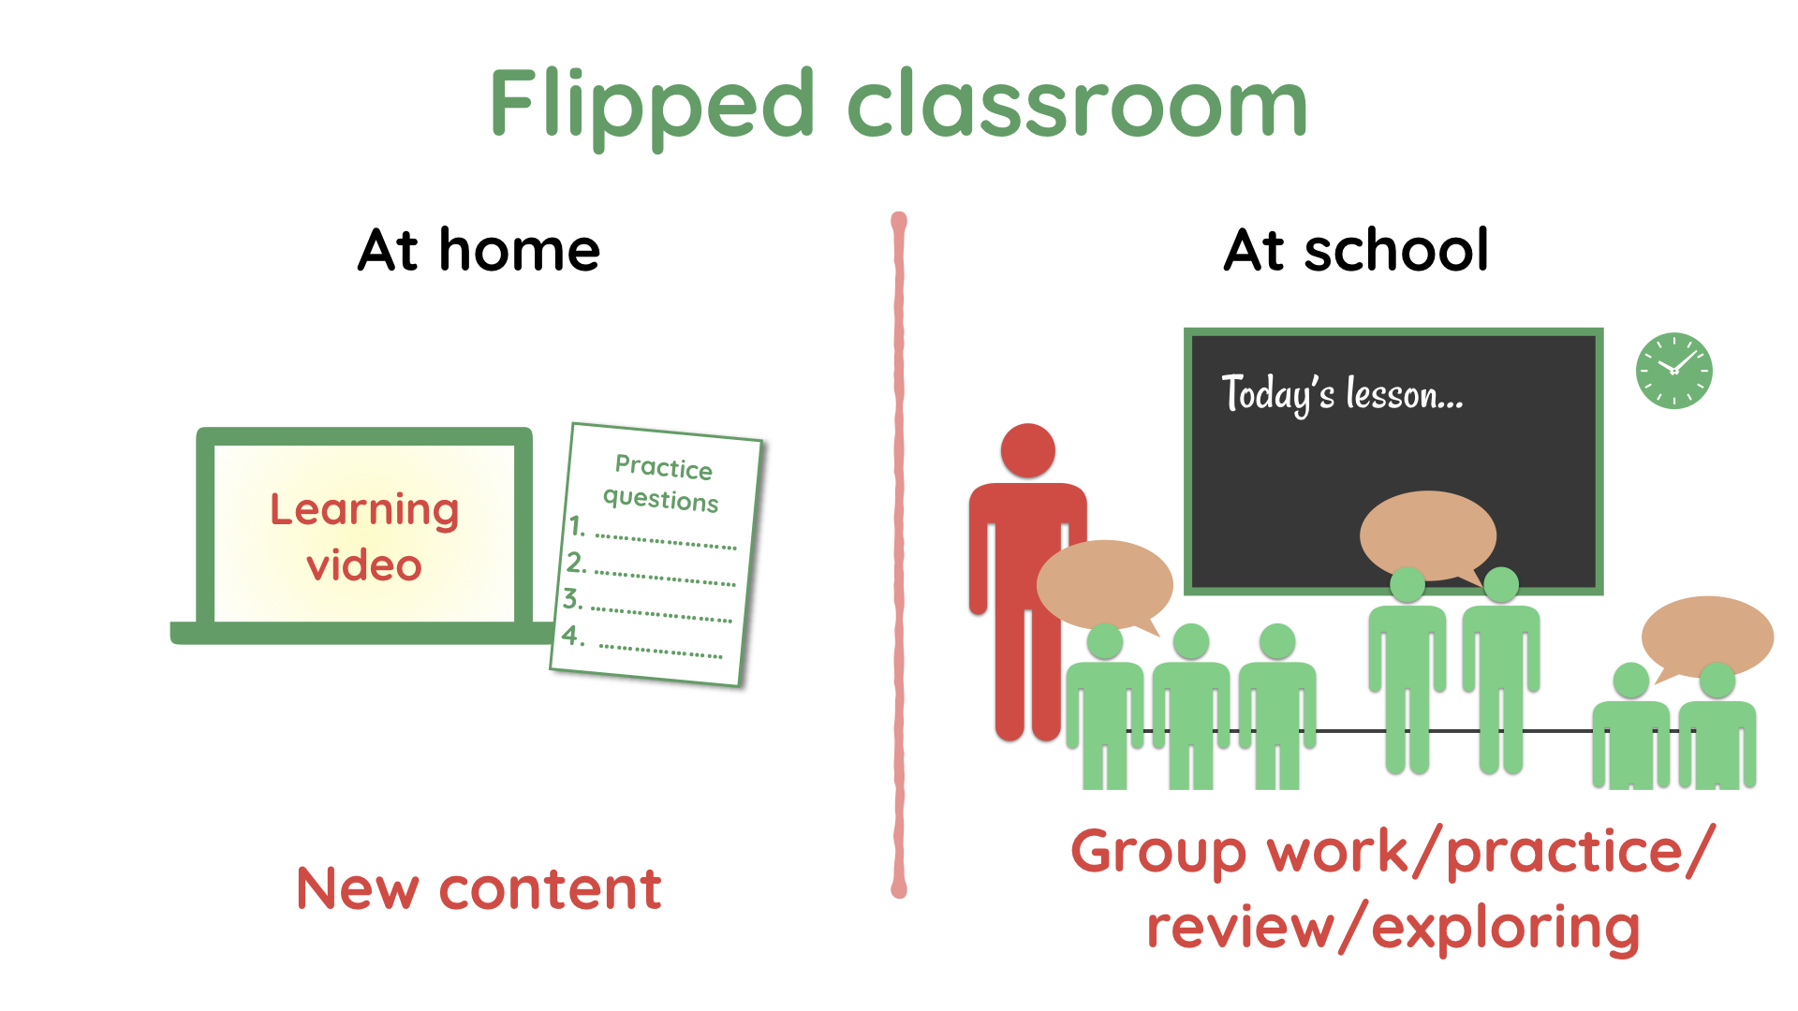
Notes:
With a flipped classroom style of teaching, students are given new content as homework BEFORE the lesson, and then do the “homework” at school, or do peer discussion-based collaborative tasks.
It should be emphasised that videos are only one example of a way to share the content. News articles, podcasts, and other media are amongst the many ways information can be shared. The course textbook is often a suitable resource (albeit generally a less interesting tool to use).

Slide 5
Notes:
There are a number of possible tasks that teachers may arrange for the flipped lesson. This is a great opportunity for teachers to get creative.
(Note: Barrier drawings involve one student describing a picture to a student, while the second student, who can’t see the drawing, must draw it. This is very good for ESL lessons, but other subjects as well where there is important visual content.)

Slide 6
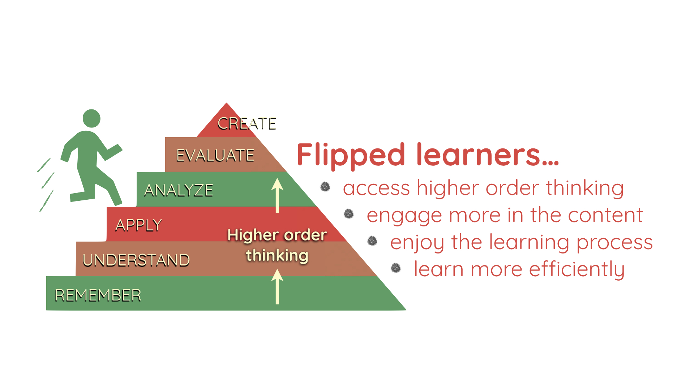
Notes:
Flipped learning ensures that all students have reached the “remember” level, and most will have reached the “understand” level, before they even come to class. The in-class activities can help students reach higher order thinking, which may otherwise be impossible without having foundational knowledge when arriving at class.

Slide 7
Notes:
This is an example of the pre-class learning task students may do.
GIVE TEACHERS THE STUDENT HOMEWORK TASK SHEET AND HAVE THEM WRITE (OR AT LEAST LOOK OUT FOR) THE ANSWERS WHILE WATCHING THE VIDEO.
After teachers watch the video remind them that when students are working alone at home they have the opportunity to pause and skip back to clarify details of the work.

Slide 8
Notes:
Video also available here: https://www.youtube.com/watch?v=Vm3MWy3lY4Q

Slide 9
Notes:
This is the handout that students are given for the in-class activity. It encourages students to creatively re-formulate their understanding of protein synthesis.

Slide 10
Notes:
This is an example of a completed task, which gives an idea of how students may approach the task.
Points to note:
The student has been very creative in their concepts (“create” is at the top of Bloom’s taxonomy)
The student has added a comic twist to the diagram (“Make DNA great again”) suggesting this was an enjoyable task.
This was created by a high-attaining student. Lower attainers may only be able to reproduce the diagrams presented in the video (or textbook) without being as creative, but this acts to solidify their understanding (“understand” is a lower order of thinking, and allows the to “apply” it. This is effective differentiation which accounts for a range of learner levels, allowing all students to complete the task to a standard in line with their ability.

Slide 11
Notes:
The most convenient way to share videos is via Youtube. It’s very quick and easy to create an account (but you may need a gmail email address).
Youtube gives videos web addresses that are “ugly”. The example address shown above would be very difficult to share with students on the board (students would likely misread it and make typing errors when entering the web address in their browser). It is therefore recommended that teachers find a way to share the link online, possibly using a class blog or system such as Moodle.

Slide 12
Notes:
There are a number of criticisms of flipped learning. These are each addressed on the teacher handout.
The instructing teacher may wish to discuss these one by one.
If the instructor aims to do a demo of narrating a video (this is strongly encouraged), then the “it takes too long” statement is a useful segue.

Slide 13
