Slide 1
HLa.11 Granting legal personhood to nature
HL.a Environmental Law

Slide 2
Granting Legal Personhood to Nature
HL.a.11 There are an increasing number of laws granting legal personhood to natural entities in order to strengthen environmental protection.

Slide 3
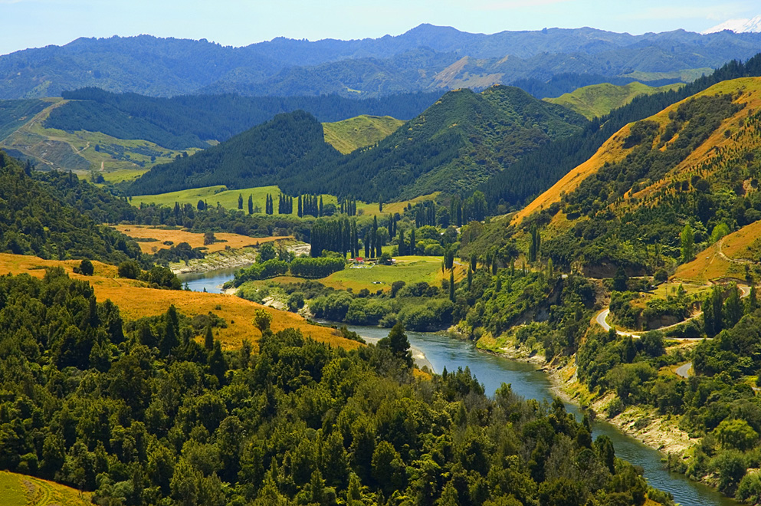
The Whanganui River
The Whanganui River was granted its own legal identity in 2017.
Two guardians represent the river:
one appointed by the government
one by the Māori iwi (tribe)
The Māori worldview sees the river as an ancestor, not property.
There is a famous Māori saying:
“I am the river and the river is me.”
A river with its own legal identity
https://en.wikipedia.org/wiki/Whanganui_River#/media/File:Whanganui_River.jpg

Slide 4
Perspectives
Give 2 key viewpoints per environmental perspective on this law:
Ecocentric
Anthropocentric
Technocentric

Slide 5
Your Opinion
In your opinion, should ecosystems have legal rights similar to humans or corporations? Justify your answer with the person next to you.

Slide 6

Evaluation
To what extent will granting legal personhood to the Whanganui River improve environmental protection? [6]
Consider the following:
What legal action can be taken, now that the river has personhood?
Will this law raise awareness in society of the “rights” of nature?
Can this set a precedent for the future?
Does the law actually prevent environmental damage?
Rights: what does the river “want”?
Discuss your answers. Then work alone to write your answer.

Slide 7
To what extent will granting legal personhood to the Whanganui River improve environmental protection? [6]
Legal personhood allows the river to be represented in court, enabling legal action against environmental damage;
Guardians advocate for the river’s interests, influencing environmental management decisions;
The law reflects Māori indigenous knowledge, encouraging stewardship of the ecosystem;
Recognizing the river’s rights reinforces intrinsic value of nature (rights-based ethics);
The law may increase public awareness and political support for protecting the river;
It can act as a precedent for similar environmental protection efforts globally;
Effectiveness depends on strong enforcement and funding;
The river still depends on human guardians and institutions to enforce its rights;
Legal complexity in determining the river’s “interests” may reduce effectiveness;
Conclusion, e.g. “Legal personhood can significantly strengthen environmental protection, but its effectiveness ultimately depends on enforcement, governance, funding, and societal support.”

