Slide 1
HLb.17 Environmental economics and the circular and doughnut economics models
HLb - Environmental Economics

Slide 2
HL.b.17 The circular economy and doughnut economics models can be seen as applications of ecological economics for sustainability.

Slide 3
RECAP
HL.b.12 Economic growth is influenced by supply and demand, and may be perceived as a measure of prosperity.
HL.b.13 Economic growth has impacts on environmental welfare.
Many nations view economic growth as analogous to success/prosperity…
…but this has environmental consequences

Slide 4
The Linear Economy (Unsustainable)
Take
Make
Use
Waste
Extract natural resources
Manufacture to make something we need/want
Consumers buy and use the item
Bin it
Economic growth has traditionally relied on a linear economy model.

Slide 5
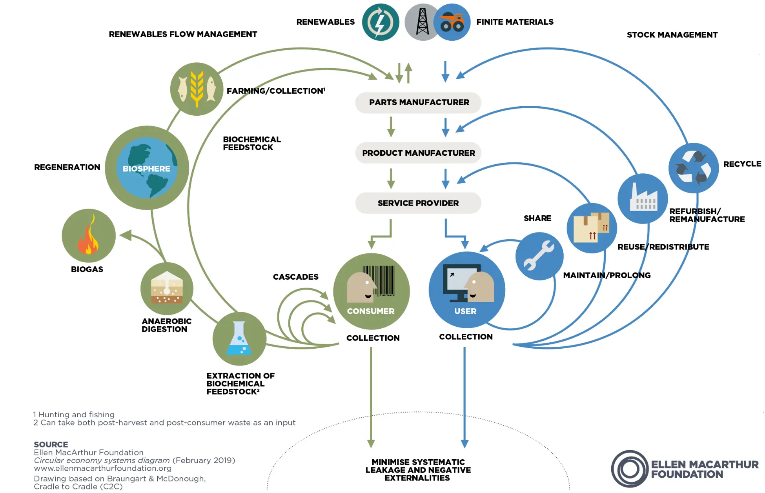
The Circular Economy

Slide 6
The Circular Economy
Strengths:
Reduces waste and resource extraction
Encourages innovation (design, materials, business models)
Can still operate within a growth-driven system
Limitations:
Expensive to implement
Requires systemic change (not just one company trying to be virtuous)

Slide 7
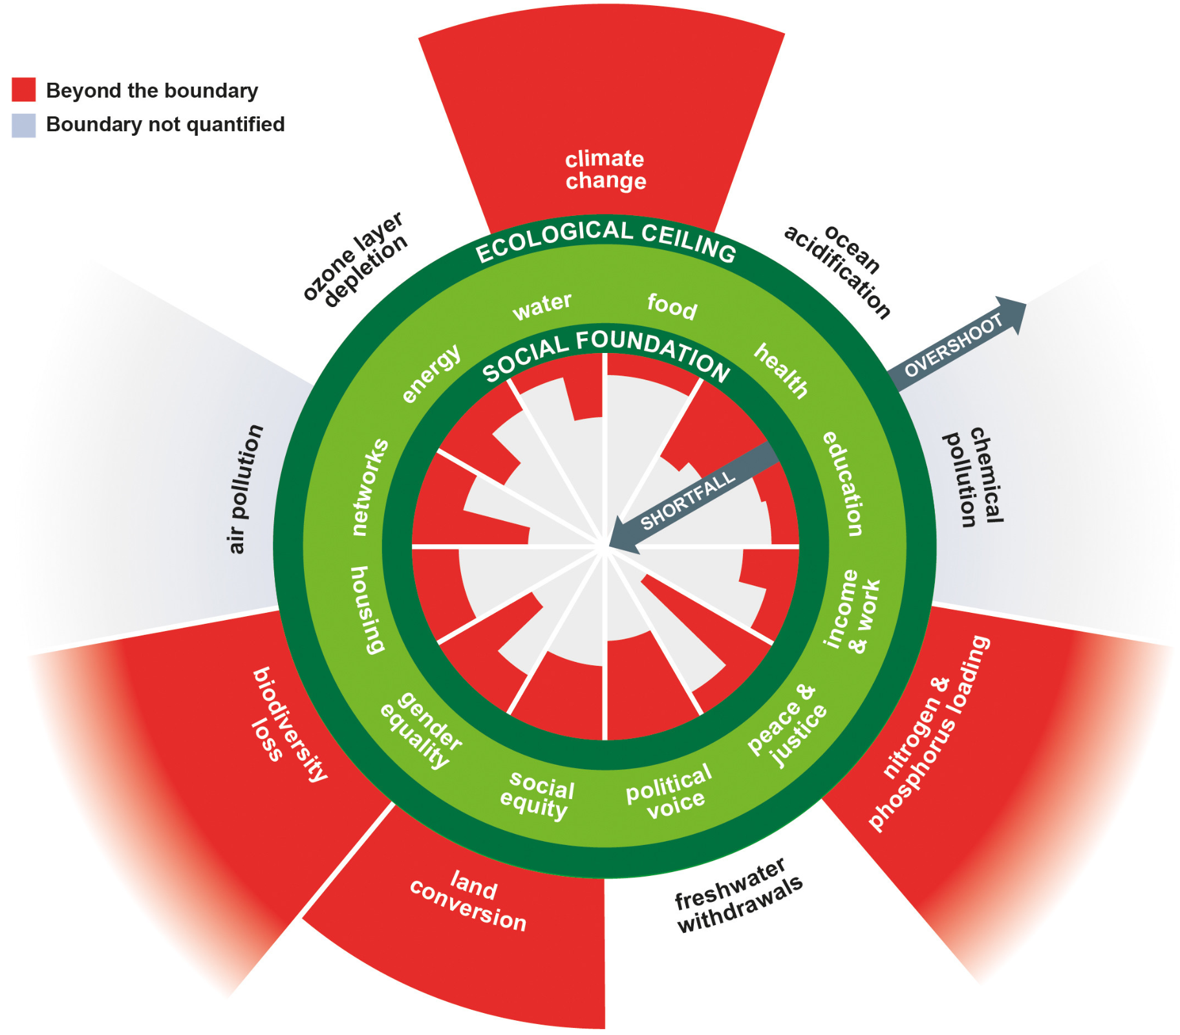
Doughnut economics
Image source: DoughnutEconomics, CC BY-SA 4.0 <https://creativecommons.org/licenses/by-sa/4.0>, via Wikimedia Commons

Slide 8
Doughnut economics
Strengths:
Directly addresses inequality
Holistic (social + environmental)
Limitations:
Hard to quantify and implement
Politically difficult (redistribution, limits to growth… good luck)
Still being tested in real-world applications
Image source: DoughnutEconomics, CC BY-SA 4.0 <https://creativecommons.org/licenses/by-sa/4.0>, via Wikimedia Commons

Slide 9

Compare and contrast the circular economy and doughnut economics models.
[4]

Slide 10
Compare and contrast the circular economy and doughnut economics models.
Both models are based on principles of sustainability and ecological economics, aiming to reduce environmental degradation;
The circular economy focuses on minimizing waste through reuse, repair, recycling, and closed-loop systems;
The circular economy includes product stewardship, where producers and users share responsibility for a product’s lifecycle;
Doughnut economics defines a “safe and just space” between a social foundation and ecological limits;
Doughnut economics explicitly addresses social inequality and human well-being, not just environmental limits;
The circular economy is more production- and industry-focused, whereas doughnut economics is a broader societal and economic framework;

Slide 11
Evaluate the effectiveness of the circular economy and doughnut economics models as models for sustainable development.
[9]

Slide 12
Evaluate the effectiveness of the circular economy and doughnut economics models as applications of ecological economics in achieving sustainable development.
Possible concepts/terminology:
Ecological economics;
Sustainable development;
Planetary boundaries;
Resource efficiency;
Closed-loop systems;
Waste as a resource;
Recycling;
Product stewardship;
GDP;
Human well-being;
Inequality;
Social justice;
Limits to growth;
Decoupling;
Landfill;
Consumerism;
Slow-growth/Zero-growth

Slide 13
Evaluate the effectiveness of the circular economy and doughnut economics models as applications of ecological economics in achieving sustainable development.
Possibly thesis statement (1/2)
Although both models aim to achieve sustainable development, doughnut economics is ultimately more effective as it directly addresses social inequality and ecological limits simultaneously, whereas the circular economy remains constrained by its compatibility with existing growth-driven economic systems.

Slide 14
Evaluate the effectiveness of the circular economy and doughnut economics models as applications of ecological economics in achieving sustainable development.
Possibly thesis statement (2/2)
While both the circular economy and doughnut economics models apply principles of ecological economics to promote sustainability, doughnut economics is flawed in that it does not factor in economic growth, and consequently does not truly facilitate all aspects of “development”.

